Slide 1
Truth Table, Characteristic Table, excitation table

Slide 2
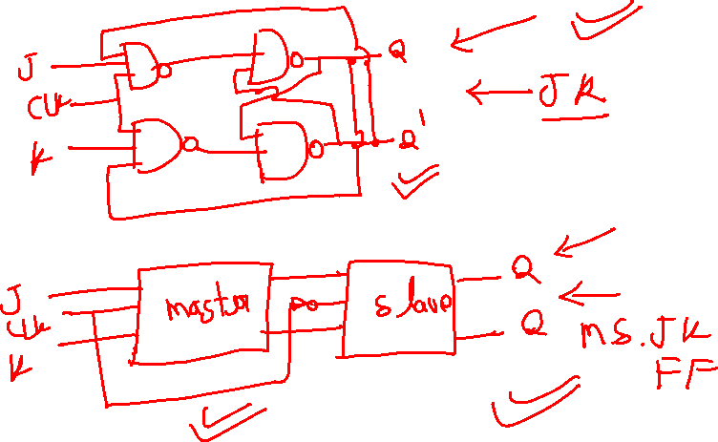

Slide 3
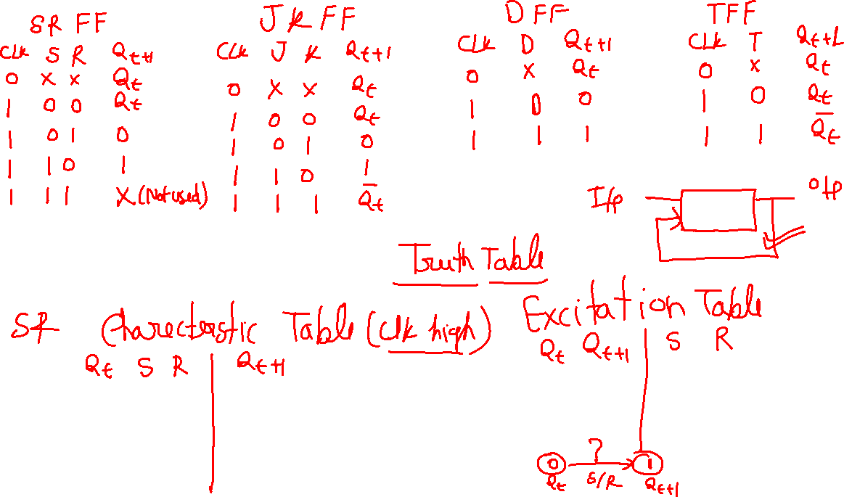

Slide 4
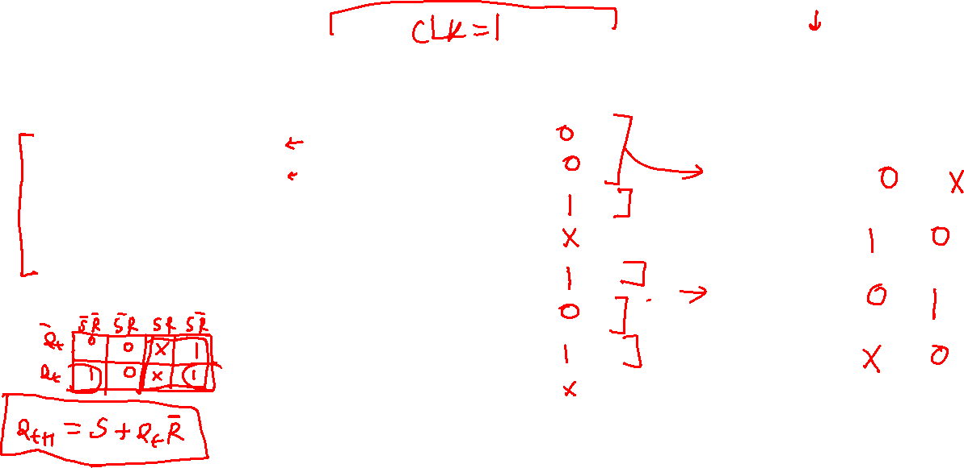
SR Flip Flop
Truth Table Characteristic Table Excitation table
Clk | S | R | Q(t+1)
0 | x | x | Qt
1 | 0 | 0 | Qt
1 | 0 | 1 | 0
1 | 1 | 0 | 1
1 | 1 | 1 | Not allow
Qt | S | R | Q(t+1)
0 | 0 | 0
0 | 0 | 1
0 | 1 | 0
0 | 1 | 1
1 | 0 | 0
1 | 0 | 1
1 | 1 | 0
1 | 1 | 1
Qt | Q(t+1) | S | R
0 | 0
0 | 1
1 | 0
1 | 1

Slide 5
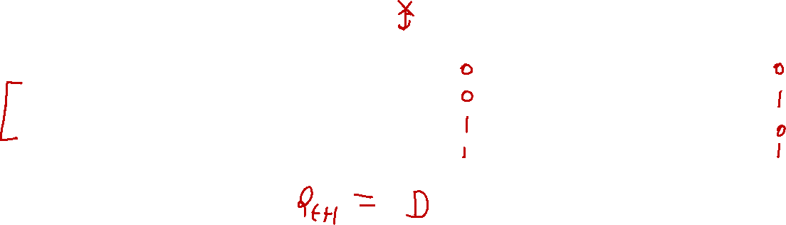
D Flip Flop
Truth Table Characteristic Table Excitation table
Clk | D | Q(t+1)
0 | x | Qt
1 | 0 | 0
1 | 1 | 1
D | Qt | Q(t+1)
0 | 0
0 | 1
1 | 0
1 | 1
Qt | Q(t+1) | D
0 | 0
0 | 1
1 | 0
1 | 1

Slide 6
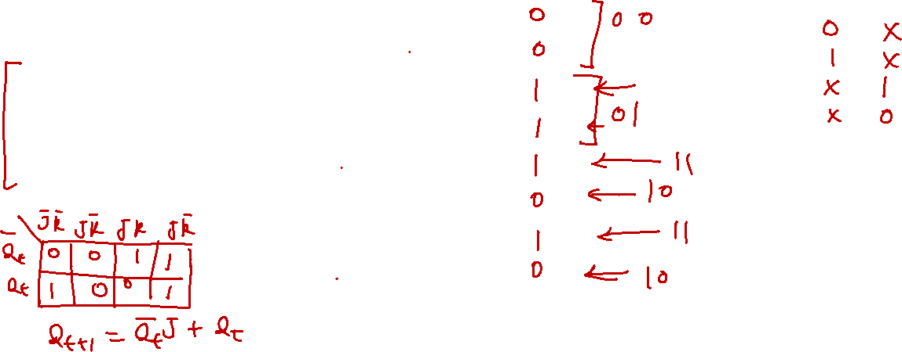
JK Flip Flop
Truth Table Characteristic Table Excitation table
Qt | J | K | Q(t+1)
0 | 0 | 0
0 | 0 | 1
0 | 1 | 0
0 | 1 | 1
1 | 0 | 0
1 | 0 | 1
1 | 1 | 0
1 | 1 | 1
Qt | Q(t+1) | J | K
0 | 0
0 | 1
1 | 0
1 | 1
Clk | J | K | Q(t+1)
0 | x | x | Qt
1 | 0 | 0 | Qt
1 | 0 | 1 | 0
1 | 1 | 0 | 1
1 | 1 | 1 | Qt’

Slide 7
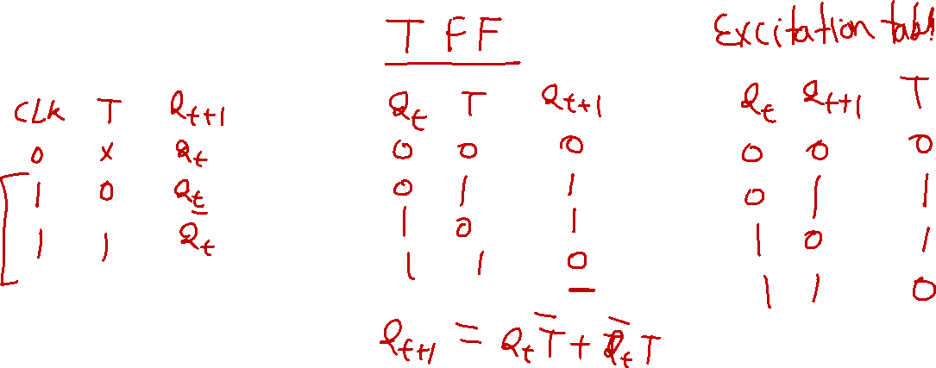
State diagram

Slide 8
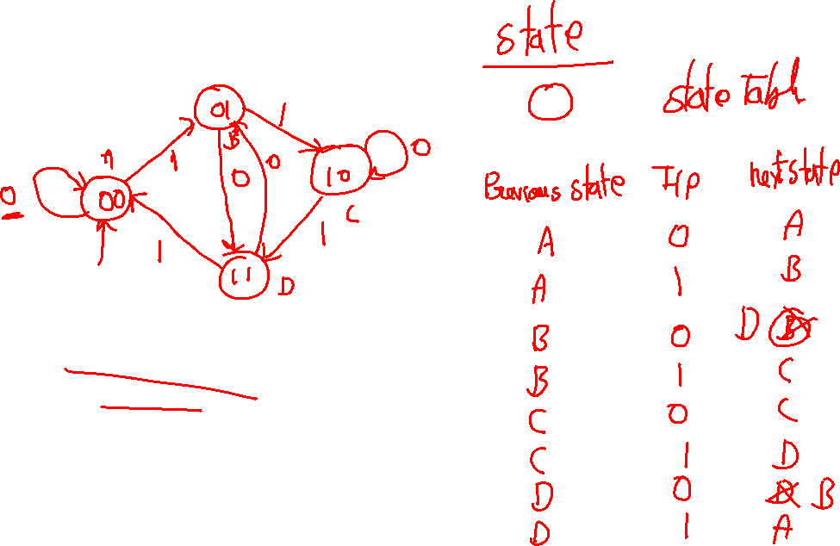
State Diagram

